Slide 1
FLS Unit 2
Johnny Vogt
DS6371

Slide 2
Quick Quiz Question
1.B
2. C
3. C
4. A statistic that is the probability of obtaining results as extreme or more extreme th was observed in a given study or experiment, assuming that the null hypothesis is true.

Slide 3
Question 2
Yes, the study is statistically significant, given the 95% confidence that the difference in means would lie between $1.23 and $1.63. Its extremely unlikely that the difference in means would equal to $0, meaning that the new marketing strategy would retain a profit per day. The study is not practical after learning that the new strategy would cost $5 per day. The problem lies in the fact that it’s very unlikely that the profit would exceen $5 per day consistently enough to make this decision to start the new marketing stregy. prudent and wise.

Slide 4
Question 3
8.013
6 and 10
Standard Deviation of 500 : .696
The shape show s a normal distribution, which is a bell shape. It’s very narrow as it should be as you gather means of means.
Different Samples
Mean : 7.998 SD: .475
Mean: 8.050 SD: 1.111
Mean:7.999 SD .224
Shape of the distribution relative to the original population
A lot Skinnier, buts holds a small semblance of the shape
Still just as skinny, arguably more skinny
Super Skinnye

Slide 5
Question 3 Cont.
Standard Error of Means: .068
.475, the SE is much lower
.343, it’s a bit closer
.224, a lot closer to it
AS the Sample size grows, the closer to the population Distribution
I would expect it to narrow even further
Yes, the pattern would continue. As the sample size grows the Sample will resmple closer to the population and the collection of sample means would get narrower towards the mean of the population

Slide 6
Question 4
First Example: I probably need some more explanation between what the standard deviation and the Margin of Error for the Confidence Level. I had gotten a bit confused because one was about the spread of the population distribution and the other was the liklihood of where the TRUE mean would fall, but going over a bit would be nice.
Sample Ages: 25, 19, 37, 29, 40, 28, 31
n = 7
Mean 29.86
Popluation Standard Deviation: ?
S=7.08
T critical value: 2.447
When th example changed it up from t to z, the margin of Error, shrunk, since we could confidently calulate values with a true standard deviation.

Slide 7
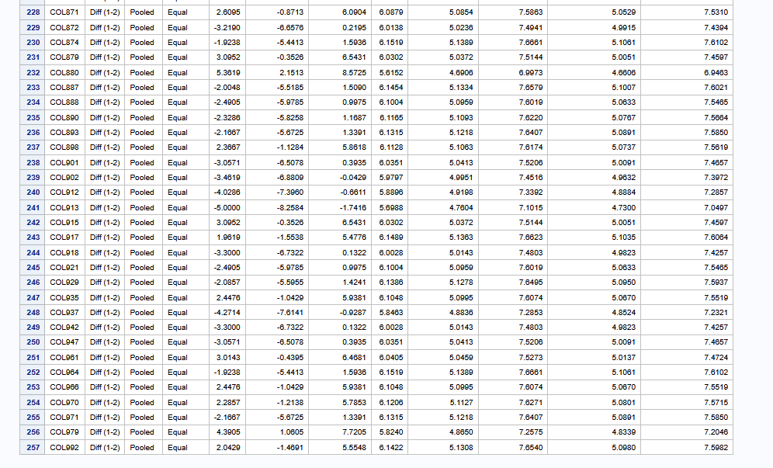
Question 5: American Samoa Government Suit
Permutation:
Only 257 of 1000 permutations would fit within a 95 % Confidence Level
H0:μ1 – μ2 = 0
Ha: μ1 – μ2 ≠ 0
Pvalue: .257
Given that this is a random sample of fired/not fired employees of the American Samoa Government. We should be able to generalize this sample to a larger population, if we are to assume that the sample was created in a situation where each individual of the American Samoa Government had an equal chance of being in the sample.
Conclusively, given this sample, we are unable to determine that the null Hypothesis is false. The P-Value of the study is .257, demonstrating that the probability of achieving a statistic that is more extreme than this value is roughly 26%. This value is not low enough for us to assume that the difference in population means is different than 0.

Slide 8
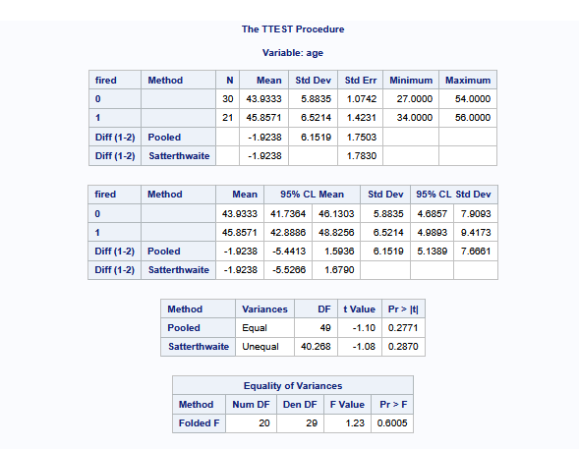
Question 5: 2 Sample Test Hypothesis Test
H0:μ1 – μ2 = 0and Ha: μ1 – μ2 ≠ 0
Significance Level: .05
Critical Values: (-5.4413, 1.5936)
T-Stat: -1.10
P-Value: .2771
Fail to Reject H0
Given the two samples and that the assumption of the null hypothesis is true, we’re 95% confident that difference in sample means would fall within the -5.4413 and 1.5936. This observation does not provide strong enough evidence for us to assume that the difference in mean age of fired and not fired employees are different than 0.

Slide 9
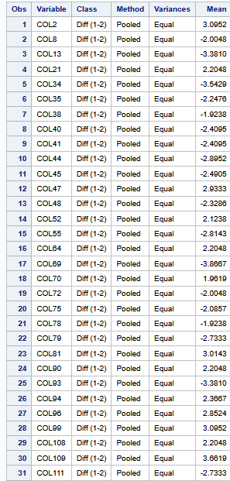
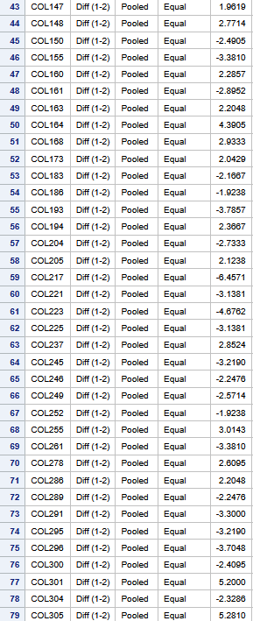
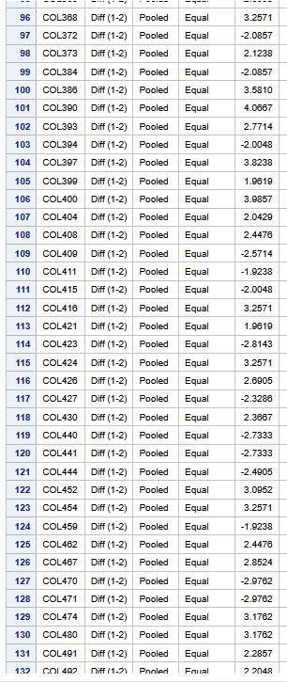
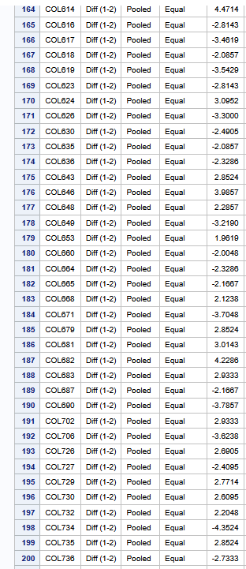
Q5? More permutations results? I’ve got 257
95% Confidence Interval: -5.5 – 1.68

Slide 10
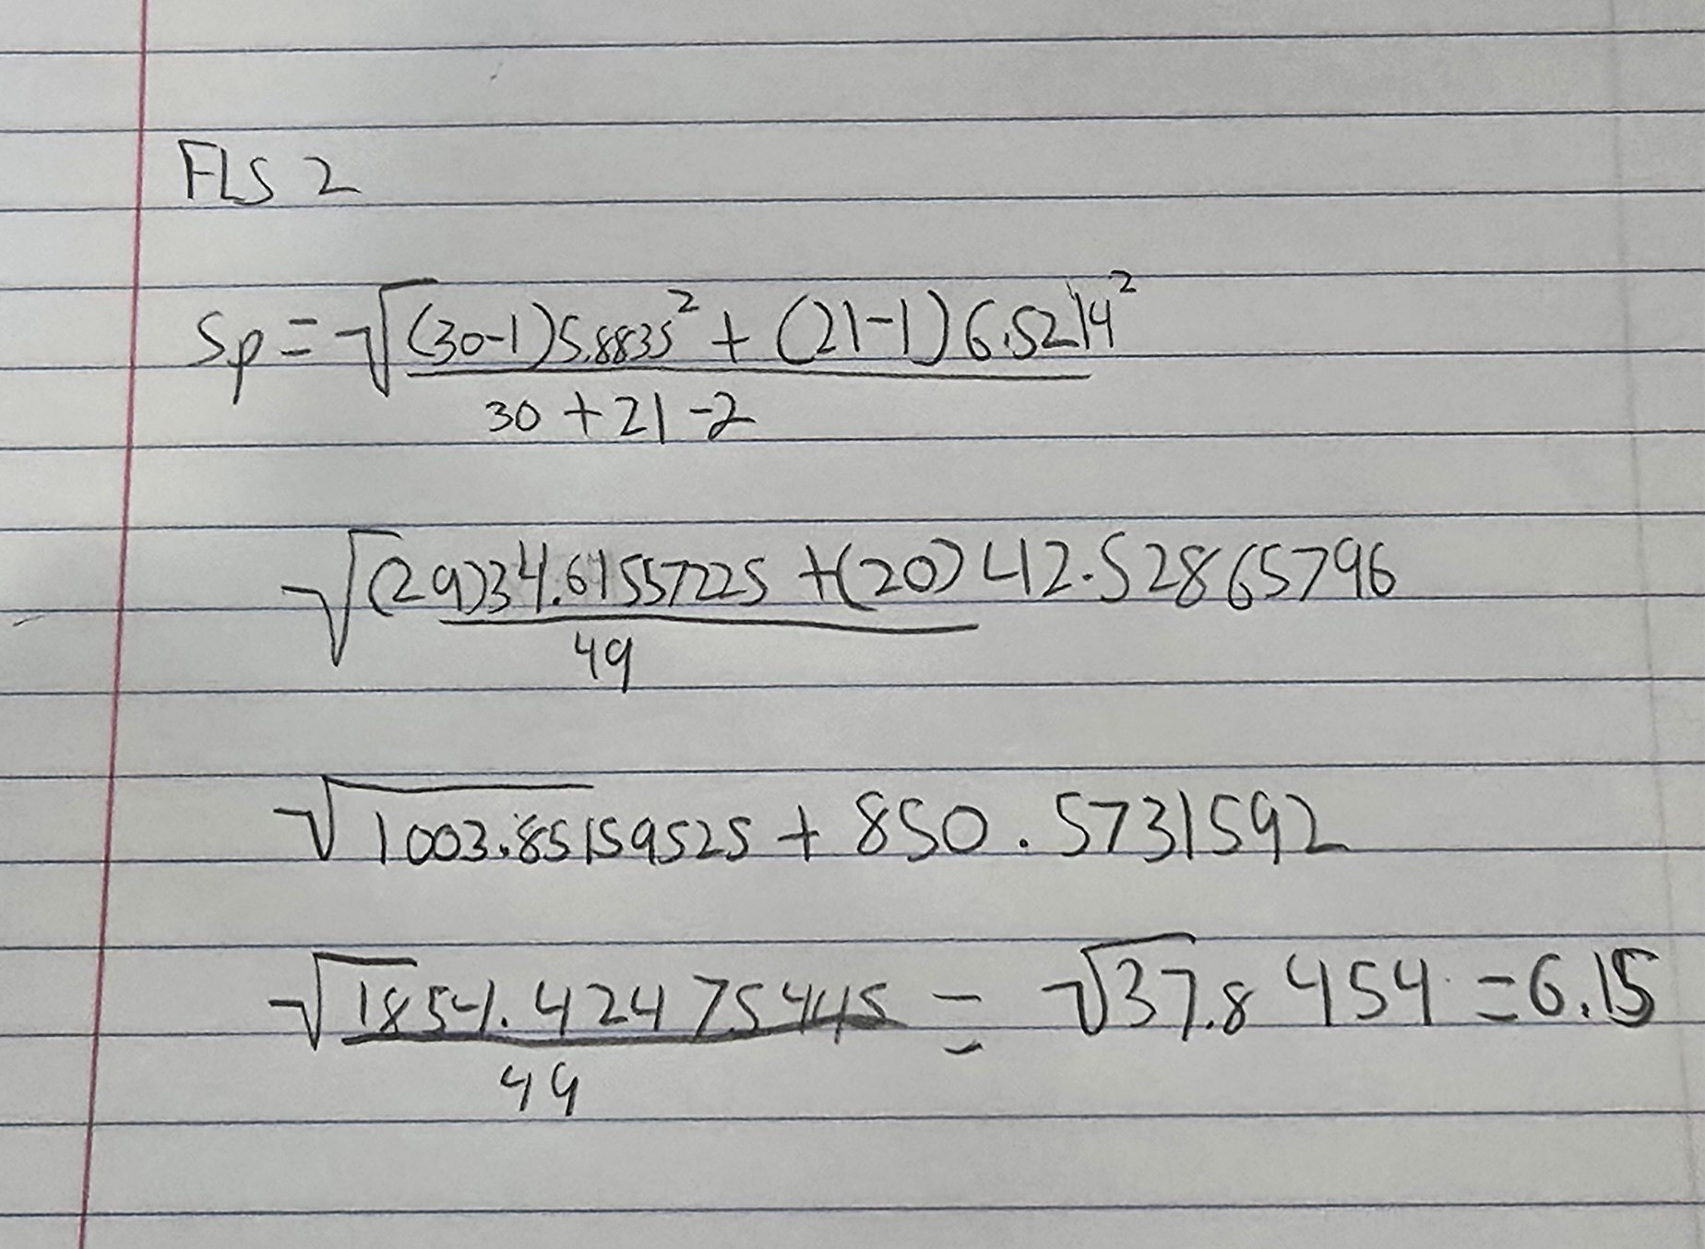
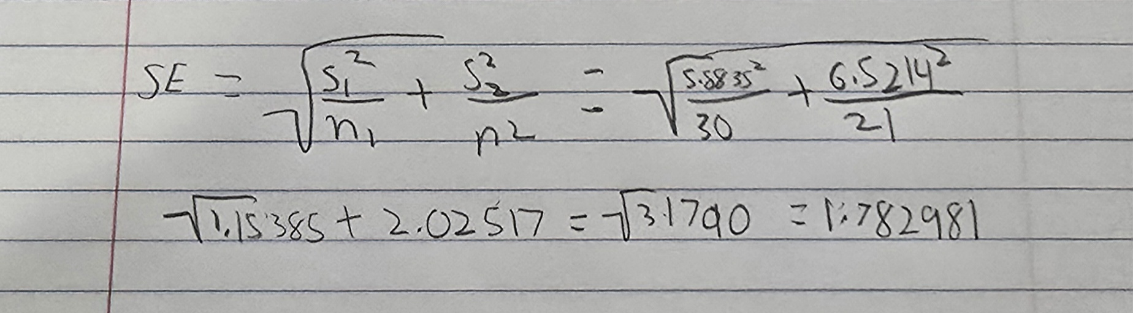
Q5: E Calculate by hand
Pooled Standard Deviation
Standard Error of Difference in Sample Means

Slide 11
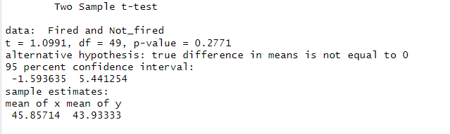
R Code Comparison

Slide 12
Takeaways
I spent longer than I should’ve trying to find the difference between Standard Error and Standard Deviation
Is there a way to install SAS Locally, it timed out on me and lost my progress.
Hammering down on CLT and hypothesis testing, must be important
I wasn’t too sure what you wanted with Question 5, the one where the jury wanted more differences shown to them.

